Slide 1
Superstore data set
File created on: 11/25/2021 12:52:54 AM

Slide 2
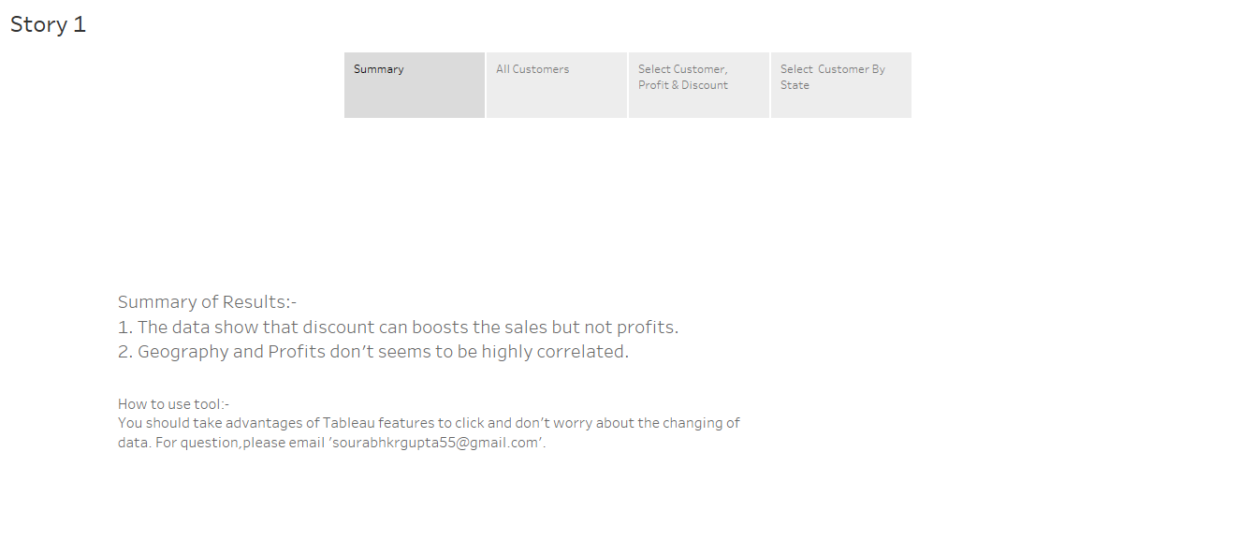

Slide 3
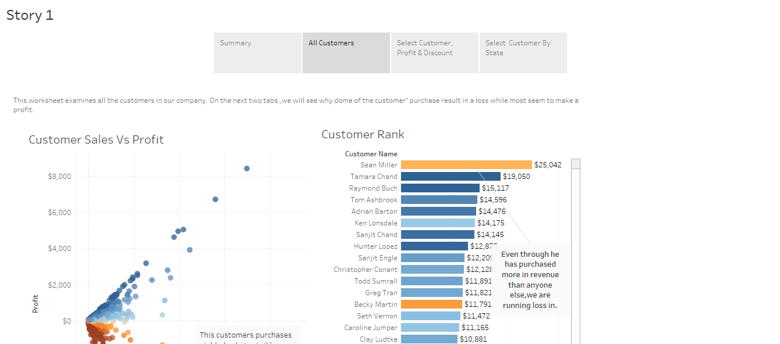

Slide 4
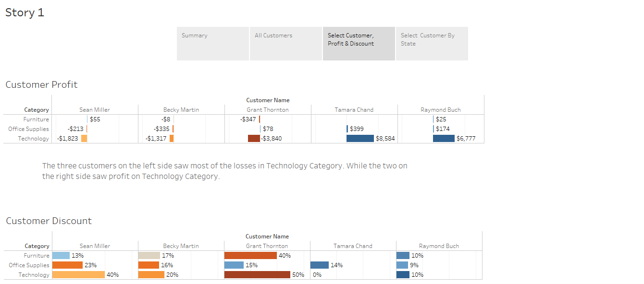

Slide 5
